Slide 1
Automotive Systems – Perception and situation understanding Simulative Robot Detection with different sensors and Kalman-filter
Prof. Dr.-Ing. Raoul Zöllner
Johannes Buyer, M. Eng.
lgerstla@stud.hs-heilbronn.de, jkurz1@stud.hs-heilbronn.de

Slide 2
Problem description
Observation of Robots in a room
Two Cameras with limited Field of View
One Lidar with low angular resolution
Only position measurable
Known state Equation of robots

Slide 3
Boundary conditions
Room Size 2D = [40 m, 30 m]
Cameras
Located in the upper two corners of the room
FOV of 40.0 degrees
Measures position in x and y
Normally distributed uncertainty with sigma of 0.2
Lidar
Located in the lower middle of the room
Angular resolution of 10 degrees
Measures distance to robot and angle of hitten beam
Normally distributed uncertainty of distance with sigma of 0.2, angular sigma 0.1

Slide 4
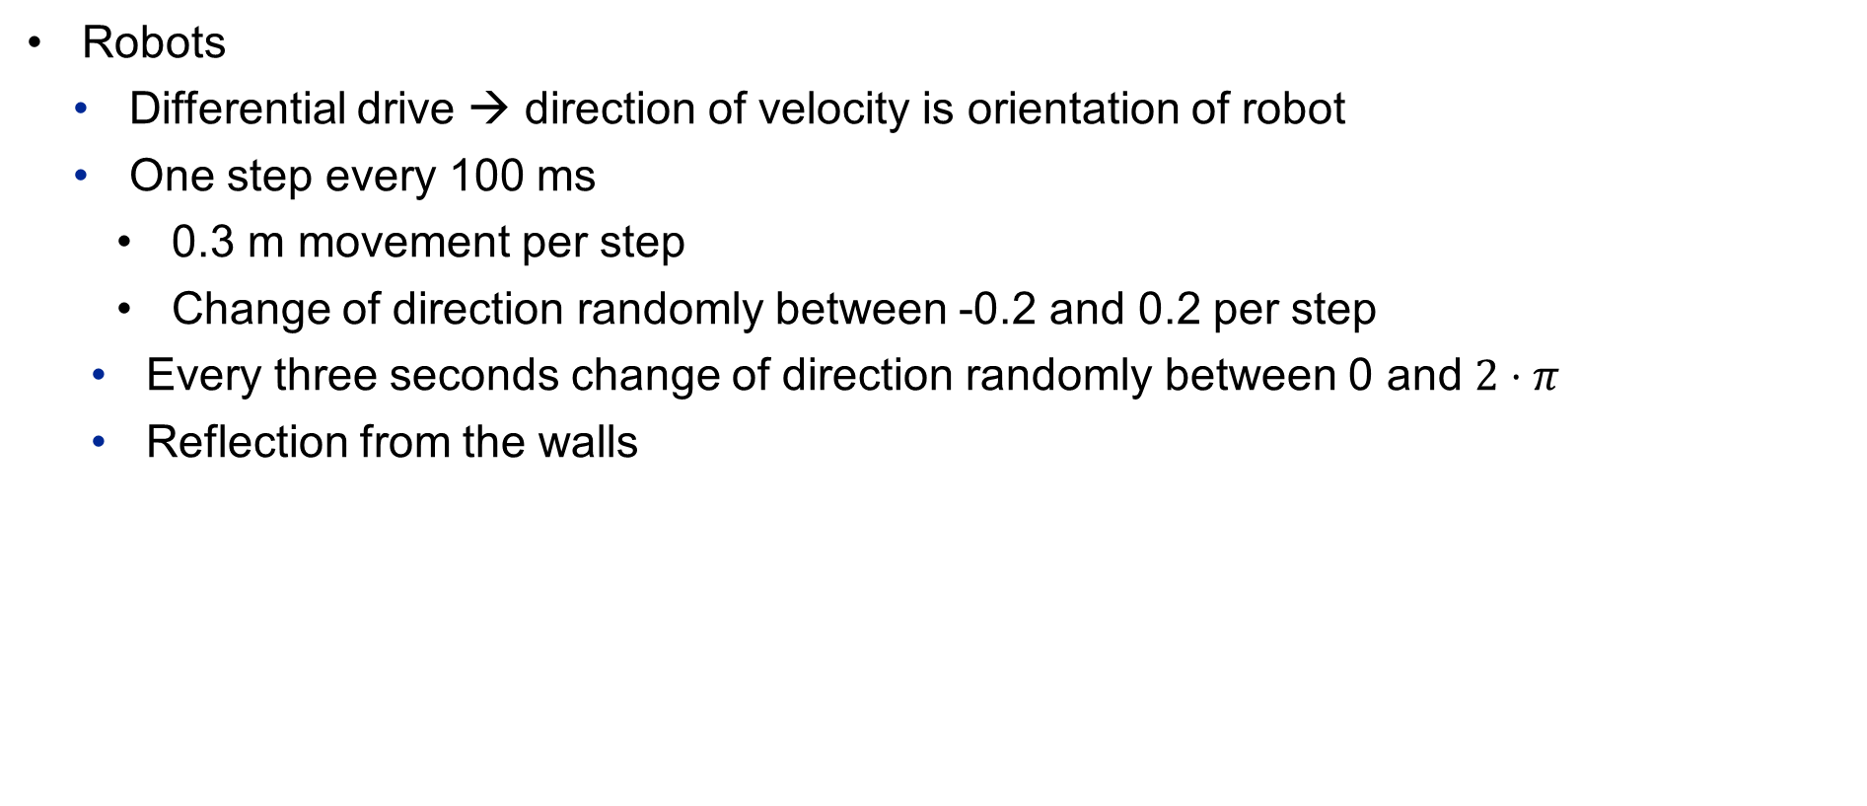
Boundary conditions
Robots
Differential drive → direction of velocity is orientation of robot
One step every 100 ms
0.3 m movement per step
Change of direction randomly between -0.2 and 0.2 per step
Every three seconds change of direction randomly between 0 and $2⋅π$
Reflection from the walls

Slide 5
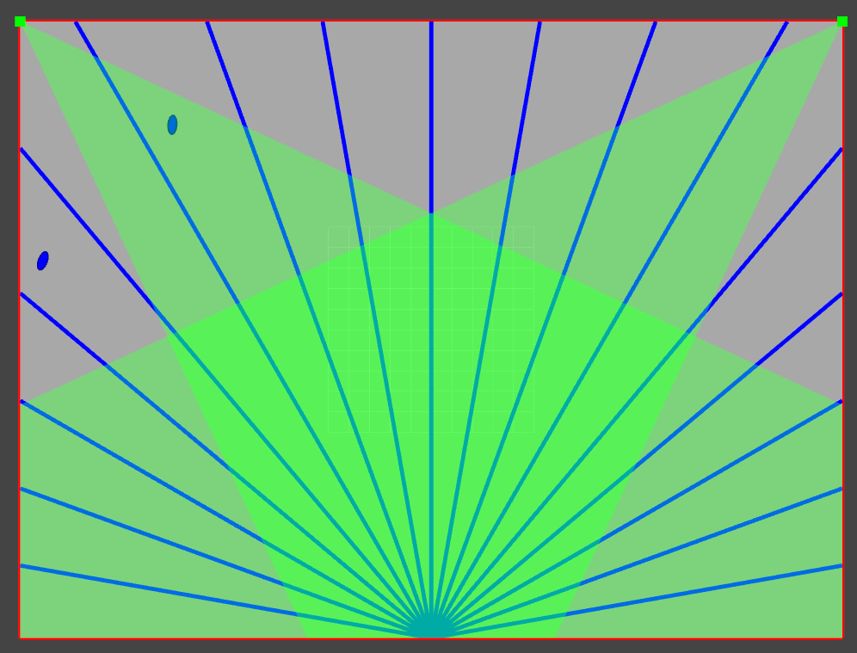
Visualization of room, Sensors and robots

Slide 6
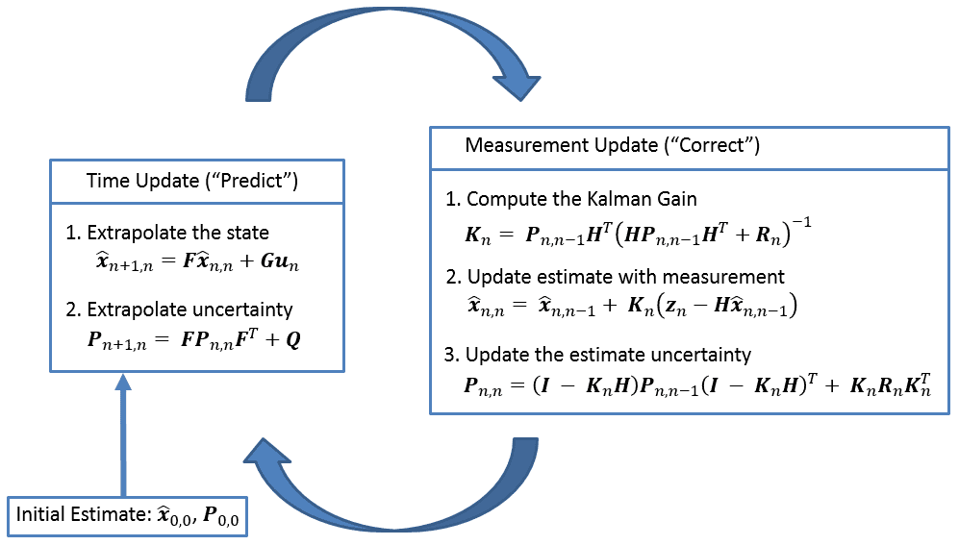
Chosen solution approach
Multi Target Tracking with Mahalanobis distance-based data association
Extended Kalman-Filer
https://www.kalmanfilter.net/img/summary/KalmanFilterDiagram.png

Slide 7
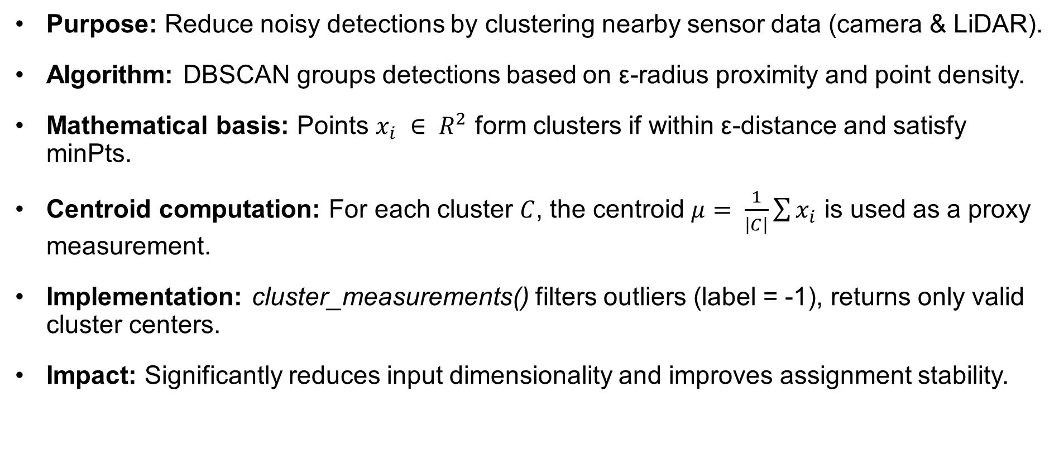
Sensor Clustering with DBSCAN – Mathematical Context & Implementation
Purpose: Reduce noisy detections by clustering nearby sensor data (camera & LiDAR).
Algorithm: DBSCAN groups detections based on ε-radius proximity and point density.
Mathematical basis: Points $x_{i} ∈ R^{2}$ form clusters if within ε-distance and satisfy minPts.
Centroid computation: For each cluster $C$, the centroid $μ= \frac{1}{\left|C\right|}\sum{x_{i}}$​ is used as a proxy measurement.
Implementation: cluster_measurements() filters outliers (label = -1), returns only valid cluster centers.
Impact: Significantly reduces input dimensionality and improves assignment stability.

Slide 8
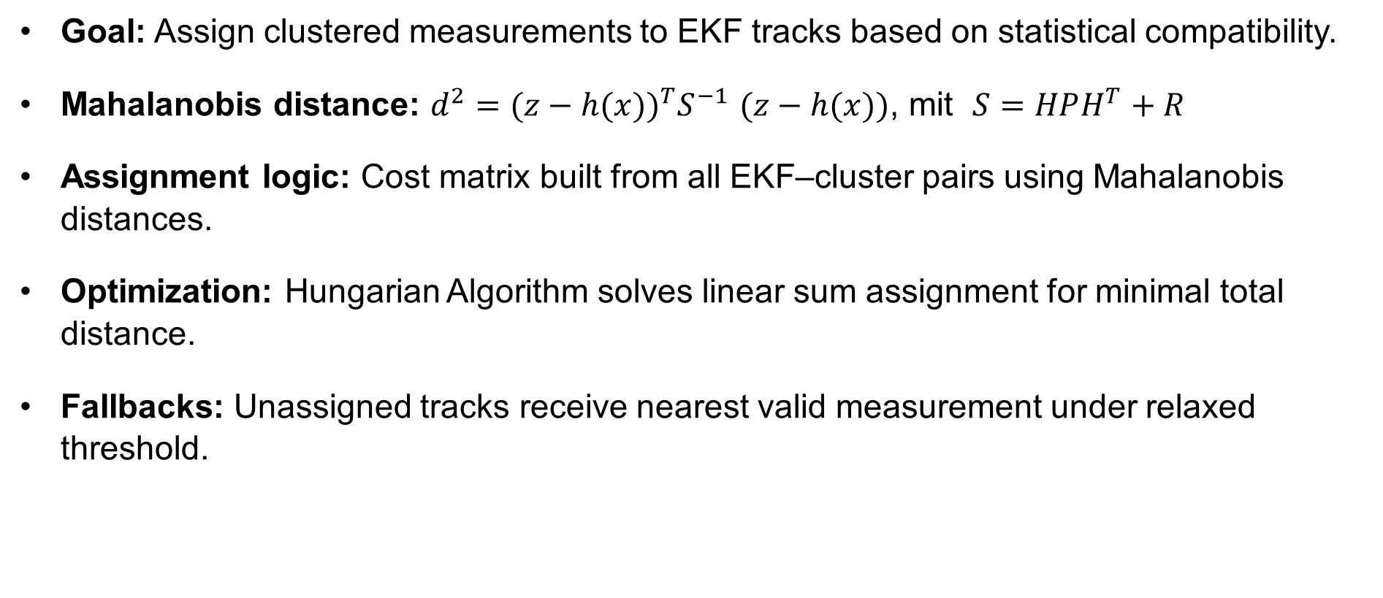
Mahalanobis Distance & Multi-Target Data Association
Goal: Assign clustered measurements to EKF tracks based on statistical compatibility.
Mahalanobis distance: $d^{2}={(z−h(x))}^{T}S^{−1}$ $(z−h(x))$, mit $S=HPH^{T}+R$
Assignment logic: Cost matrix built from all EKF–cluster pairs using Mahalanobis distances.
Optimization: Hungarian Algorithm solves linear sum assignment for minimal total distance.
Fallbacks: Unassigned tracks receive nearest valid measurement under relaxed threshold.

Slide 9

State vector, measurement vector
State vector: $x=\left[\begin{matrix}x \\ y \\ \begin{aligned}θ \\ v \\ ω\end{aligned}\end{matrix}\right]$
Input vector: $u=[ ]$
Measurement vector: $z_{camera}=\left[\begin{matrix}x \\ \begin{aligned}y \\ θ\end{aligned}\end{matrix}\right]$
$z_{lidar}=\left[\begin{matrix}x \\ y\end{matrix}\right]$

Slide 10

Motion / Transition Model
System dynamics function$: f\left(x\right)=\left[\begin{matrix}x+v⋅\cos\left(θ_{k}\right)⋅dt \\ y+v⋅\sin\left(θ_{k}\right)⋅dt \\ θ+ω⋅dt \\ v \\ ω\end{matrix}\right]$

Slide 11

Measurement Model
Measurement function: $h_{camera}\left(x\right)=\left[\begin{matrix}x \\ \begin{aligned}y \\ θ\end{aligned}\end{matrix}\right]$
$h_{lidar}(x)=\left[\begin{matrix}x \\ y\end{matrix}\right]$

Slide 12
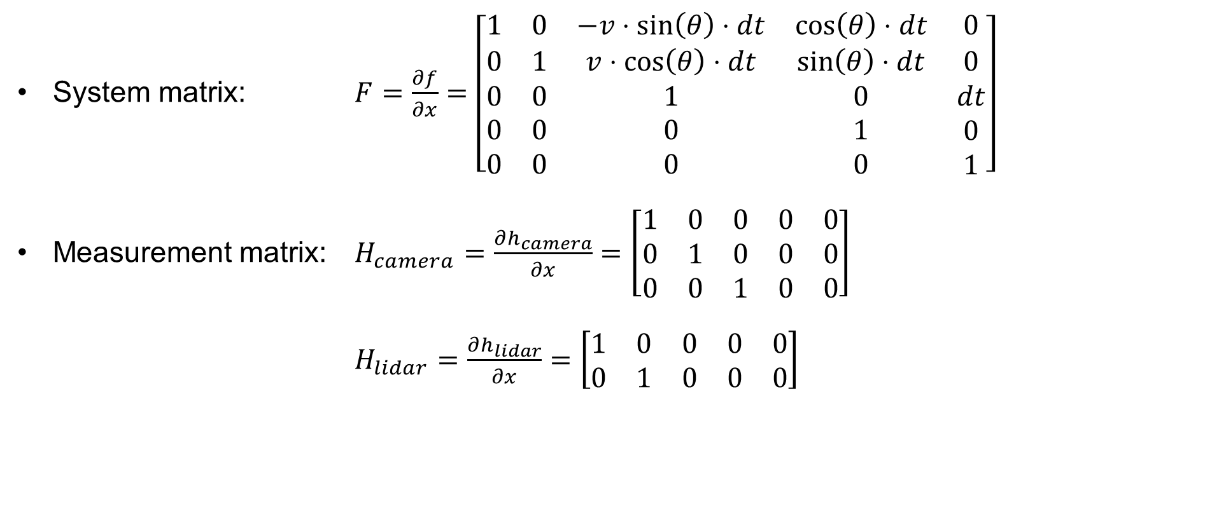
Jacobi-matrices
System matrix: $F=\frac{∂f}{∂x}=\left[\begin{matrix}1 & 0 & −v⋅\sin\left(θ\right)⋅dt & \cos\left(θ\right)⋅dt & 0 \\ 0 & 1 & v⋅\cos\left(θ\right)⋅dt & \sin\left(θ\right)⋅dt & 0 \\ \begin{aligned}0 \\ 0 \\ 0\end{aligned} & \begin{aligned}0 \\ 0 \\ 0\end{aligned} & \begin{aligned}1 \\ 0 \\ 0\end{aligned} & \begin{aligned}0 \\ 1 \\ 0\end{aligned} & \begin{aligned}dt \\ 0 \\ 1\end{aligned}\end{matrix}\right]$
Measurement matrix: $H_{camera}=\frac{∂h_{camera}}{∂x}=\left[\begin{matrix}1 & 0 & 0 & 0 & 0 \\ 0 & 1 & 0 & 0 & 0 \\ 0 & 0 & 1 & 0 & 0\end{matrix}\right]$
$H_{lidar}=\frac{∂h_{lidar}}{∂x}=\left[\begin{matrix}1 & 0 & 0 & 0 & 0 \\ 0 & 1 & 0 & 0 & 0\end{matrix}\right]$

Slide 13
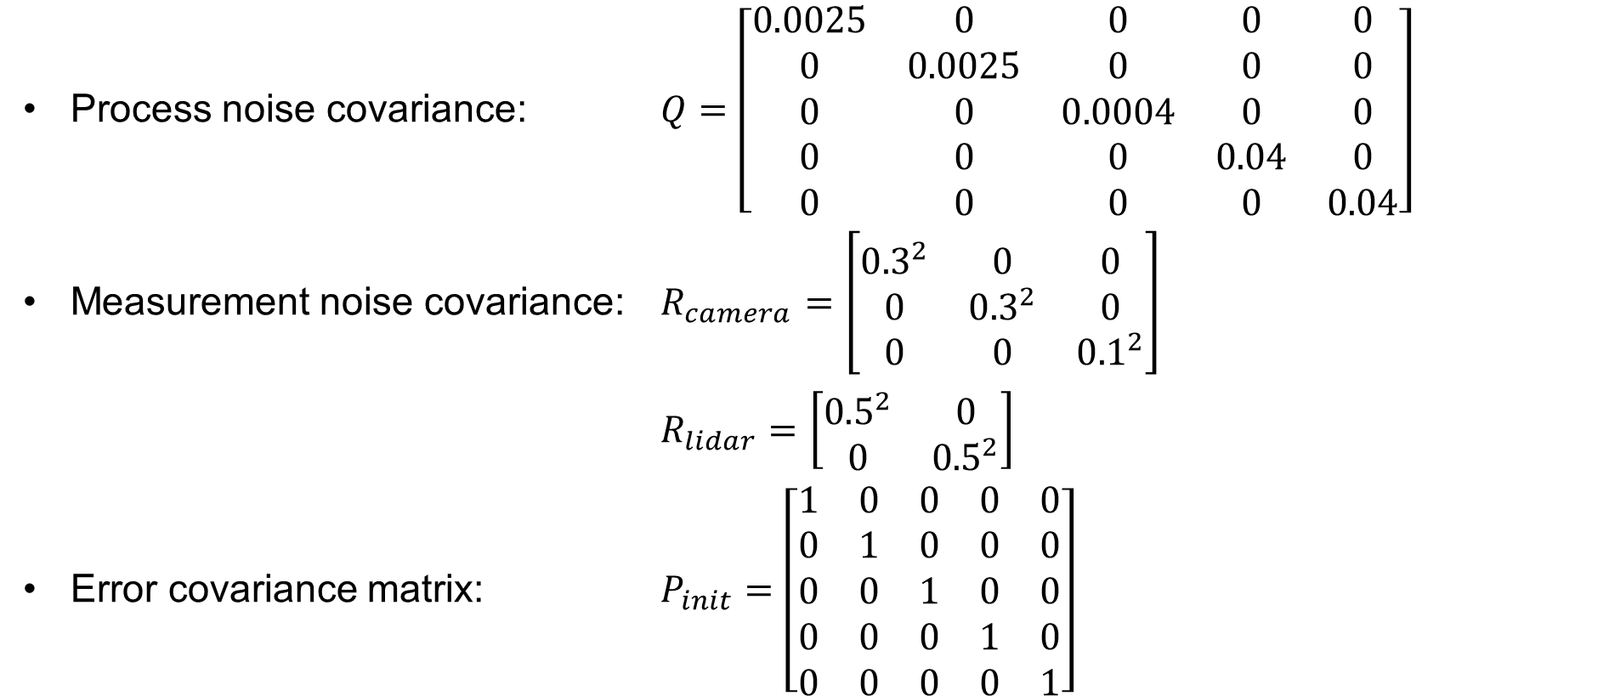
Parameterization of the filter
Process noise covariance: $Q=\left[\begin{matrix}0.0025 & 0 & 0 & 0 & 0 \\ 0 & 0.0025 & 0 & 0 & 0 \\ 0 & 0 & 0.0004 & 0 & 0 \\ 0 & 0 & 0 & 0.04 & 0 \\ 0 & 0 & 0 & 0 & 0.04\end{matrix}\right]$
Measurement noise covariance: $R_{camera}=\left[\begin{matrix}{0.3}^{2} & 0 & 0 \\ 0 & {0.3}^{2} & 0 \\ 0 & 0 & {0.1}^{2}\end{matrix}\right]$
$R_{lidar}=\left[\begin{matrix}{0.5}^{2} & 0 \\ 0 & {0.5}^{2}\end{matrix}\right]$
Error covariance matrix: $P_{init}=$ $\left[\begin{matrix}1 & 0 & 0 & 0 & 0 \\ 0 & 1 & 0 & 0 & 0 \\ 0 & 0 & 1 & 0 & 0 \\ 0 & 0 & 0 & 1 & 0 \\ 0 & 0 & 0 & 0 & 1\end{matrix}\right]$

Slide 14
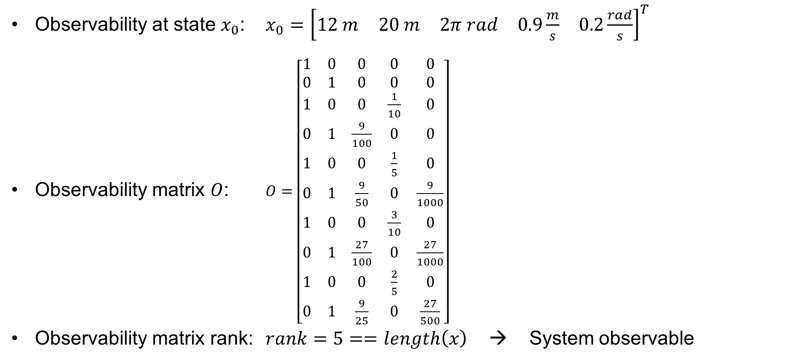
observability
Observability at state $x_{0}$: $x_{0}={\left[\begin{matrix}12 m & 20 m & 2π rad & 0.9\frac{m}{s} & 0.2\frac{rad}{s}\end{matrix}\right]}^{T}$
Observability matrix $O$: $O=\left[\begin{matrix}1 & 0 & 0 & 0 & 0 \\ 0 & 1 & 0 & 0 & 0 \\ 1 & 0 & 0 & \frac{1}{10} & 0 \\ 0 & 1 & \frac{9}{100} & 0 & 0 \\ 1 & 0 & 0 & \frac{1}{5} & 0 \\ 0 & 1 & \frac{9}{50} & 0 & \frac{9}{1000} \\ 1 & 0 & 0 & \frac{3}{10} & 0 \\ 0 & 1 & \frac{27}{100} & 0 & \frac{27}{1000} \\ 1 & 0 & 0 & \frac{2}{5} & 0 \\ 0 & 1 & \frac{9}{25} & 0 & \frac{27}{500}\end{matrix}\right]$
Observability matrix rank: $rank=5==length\left(x\right)$ → System observable

Slide 15
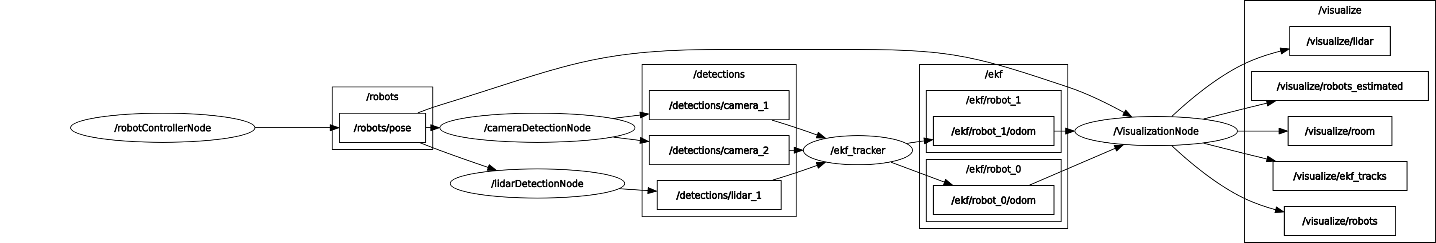
Structure of the implemented program
Implementation in ROS2 Nodes
robotControllerNode → Simulation of roboter movement
*DetectionNode → Simulation of detection with added noise
ekfNode → extended Kalman-Filter
visualizationNode → Visualization of room, roboters, sensors, covariance

Slide 16
performed experiments and results

Slide 17
Literature

Slide 18
Thank you for your attention

